Slide 1
TOMIKO & ADAM’S WEDDING
JULY 26TH, 2025
30 GUESTS
SHANGRI-LA, PARIS
WEDDING MOOD BOARD

Slide 2
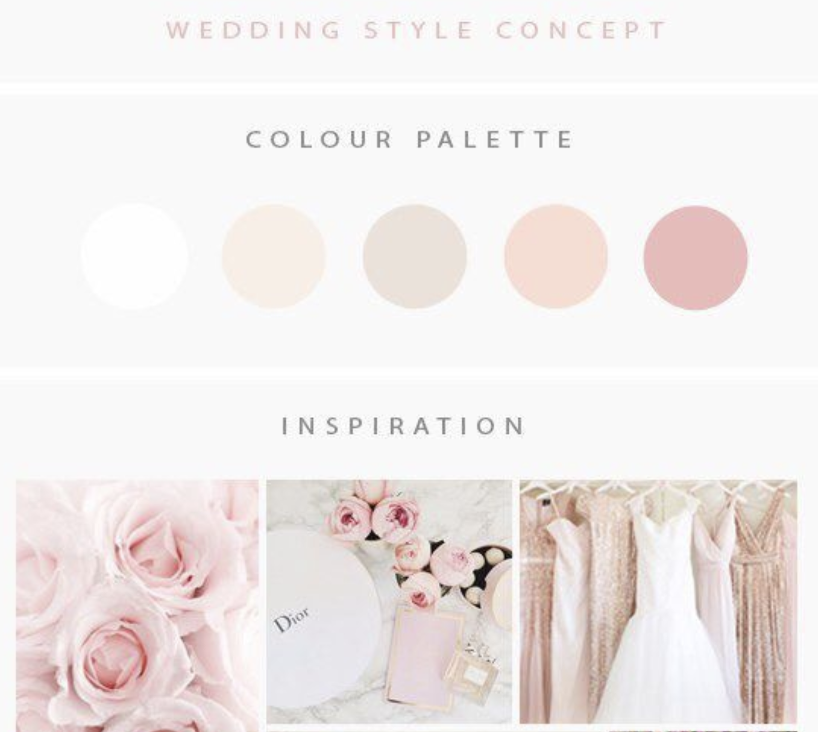
COLOR PALETTE
NOTE: COLORS WILL BE WHITE, LIGHT PINK, IVORY/CHAMPAGNE & GOLD TOUCHES

Slide 3
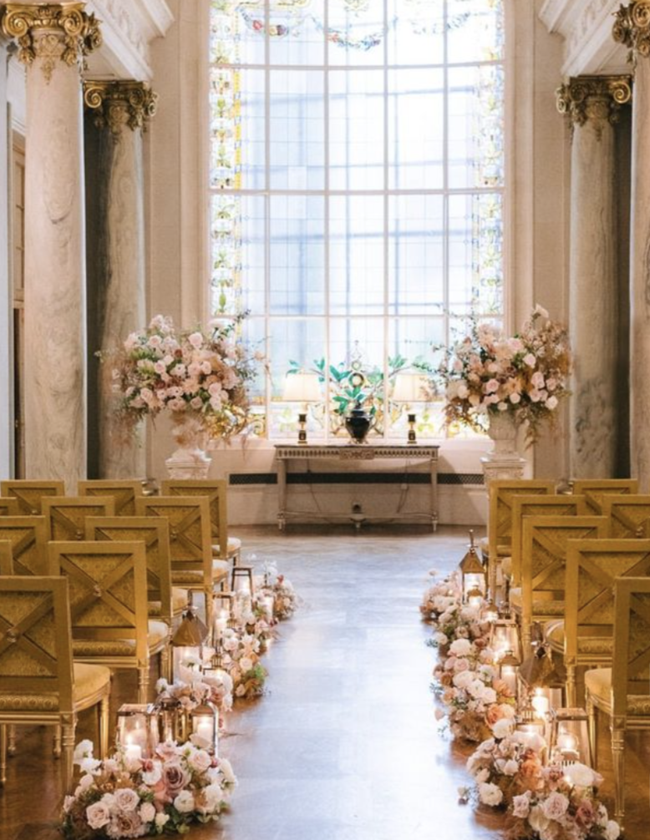
CEREMONY DECOR – GENERAL IDEA
For the ceremony décor, we will have two white columns topped with large urns filled with extra-large seasonal flower arrangements in white, pink, dusty pink, and touches of wild greenery for a “destructured” style.
The aisle will be lined with arrangements matching the altar décor—five on each side. We’re planning for 15 chairs per side, set in five rows of three.
LED candles will be placed inside cylindrical glass vases, the bases filled with granulated powder to create a realistic, glowing effect.

Slide 4
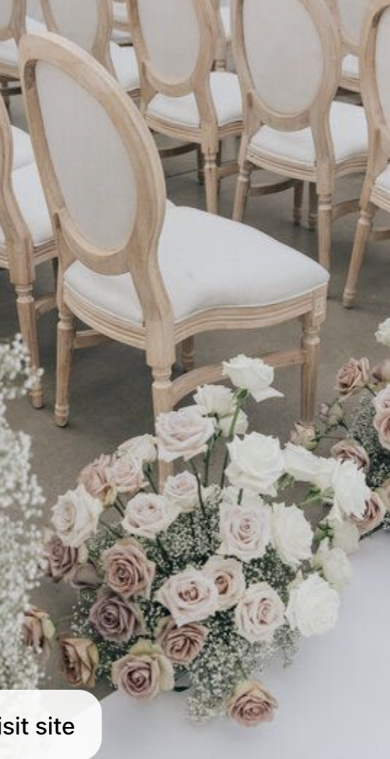
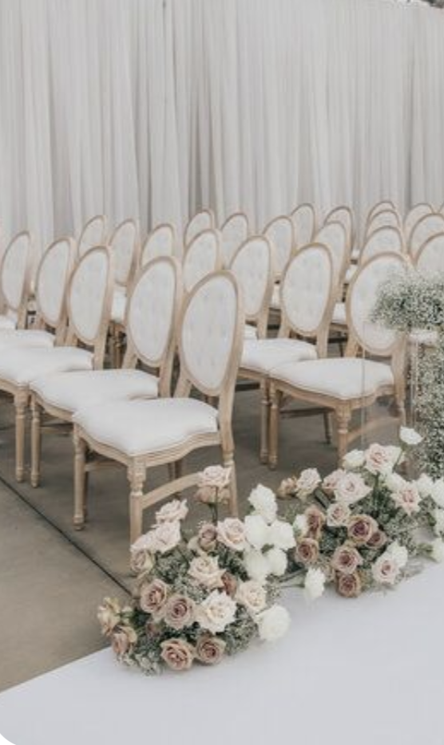
AISLE DECOR
The aisle will be elegantly adorned with medium size arrangements matching the altar décor, 5 on each side.
+ LED candles as described on the previous slides.
NOTE: We’re planning for 15 chairs per side, set in 5 rows of 3 chairs.

Slide 5
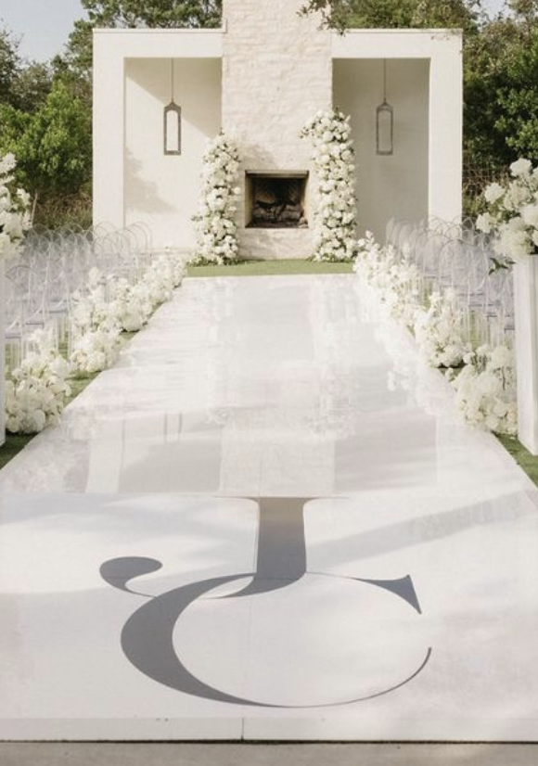
AISLE RUNNER
White glossy runner with gold initials - TBD

Slide 6
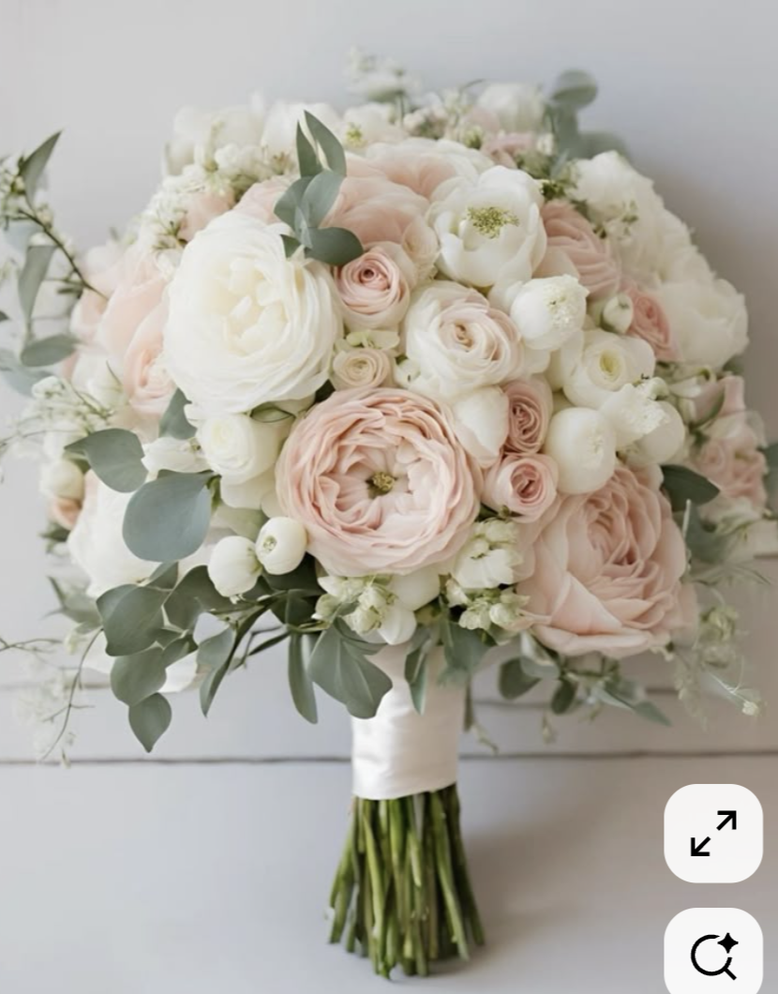
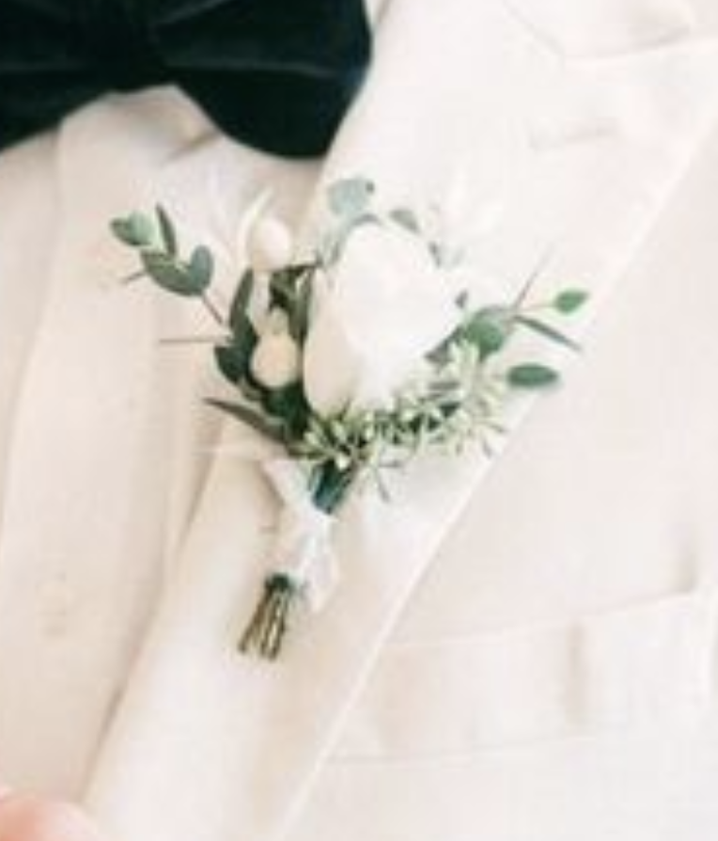
BRIDAL BOUQUET & BOUTONNIERE
For the bridal bouquet, we will aim for a medium size as picture. blushing pink and white bouquet. The stems tied with a light pink/white ribbon not wrapped all the way at the bottom.
Boutonniere as picture.

Slide 7
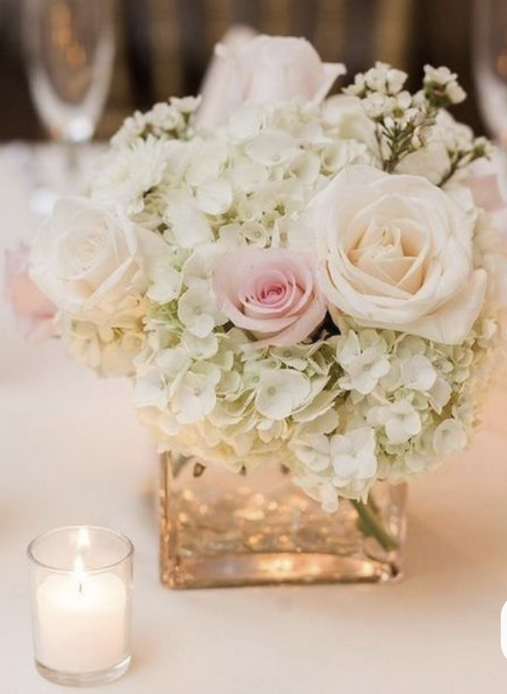
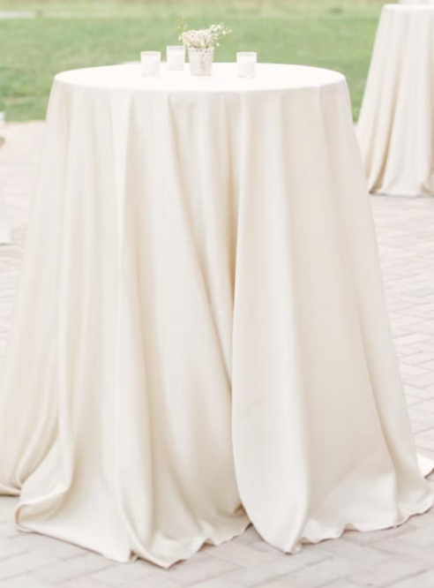
COCKTAIL
Cocktail arrangements will reflect the reference image, featuring soft touches of light pink florals paired with delicate LED votive candles. The table will be draped in a loose ivory tablecloth for an effortlessly refined and elegant look.

Slide 8
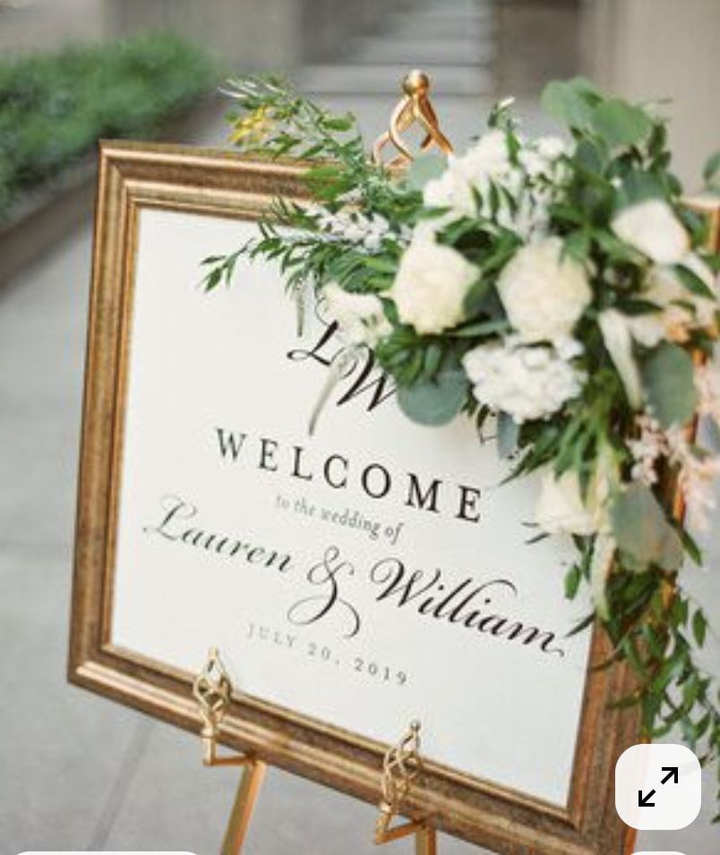
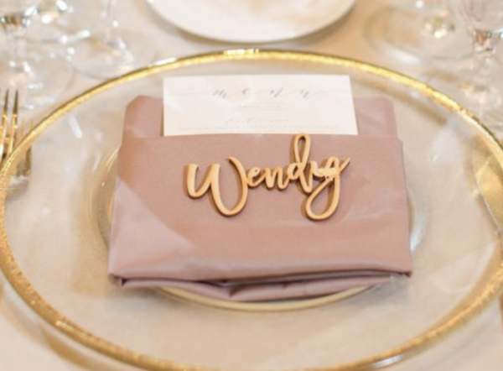
Wedding Sign & Décor + Place cards
For the welcome sign, we’ll use a design identical to the one in the photo, set in an antique gold frame, black writing and displayed on a gold easel.
For the place cards, the long rectangular table seats 15 guests per side. Each guest’s name will be placed directly at their seat on the napkin, so they can easily locate their spot.

Slide 9
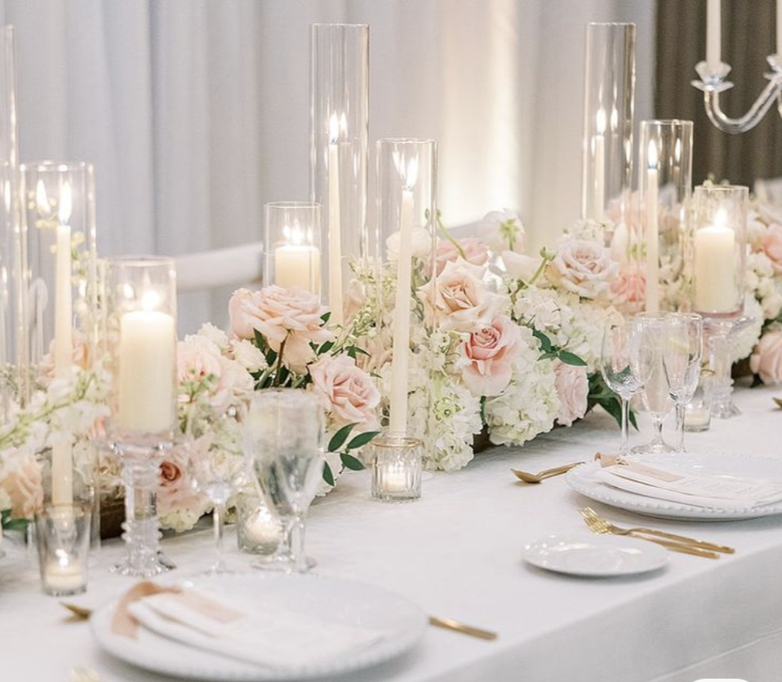
OPTION 1
Centerpieces – 1 Long rectangular table for 30 guests (15 each side)
The theme is romantic and fairytale-inspired, with warm tones of white, pink and gold (No greenery). The long, rectangular table will be adorned with a continuous garland running from one end to the other,
interspersed with a mix of clear and gold candle holders. Please note that Shangri-La has recently changed its policy and no longer permits real candles, so we will use LED candles throughout.

Slide 10
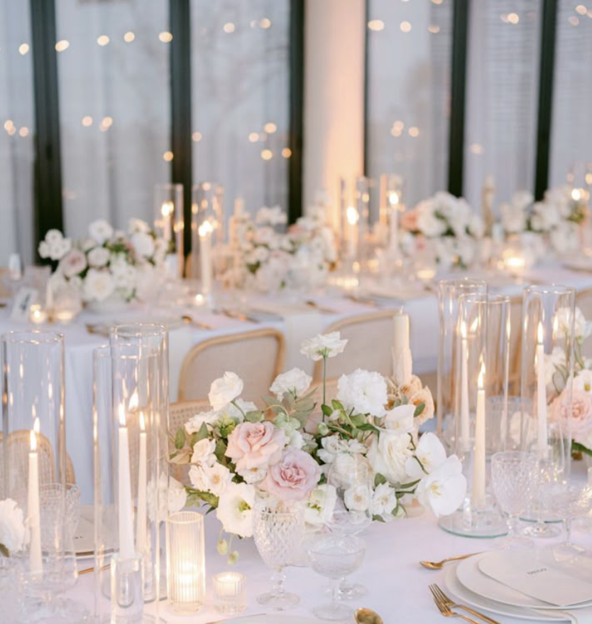
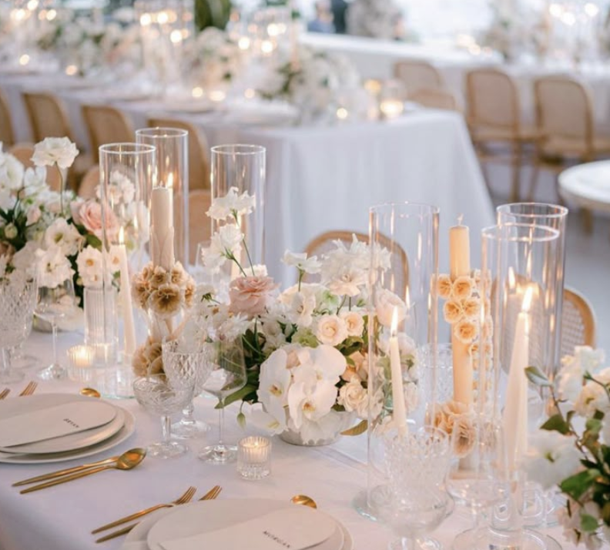
OPTION 2
Centerpieces – 1 Long rectangular table for 30 guests (15 each side)
Option 2 will follow the same overall aesthetic as Option 1. However, instead of a continuous garland running along the length of the table, we will feature medium-sized floral arrangements composed of white and light pink blooms, with no greenery, as shown in the mood board reference image.

Slide 11
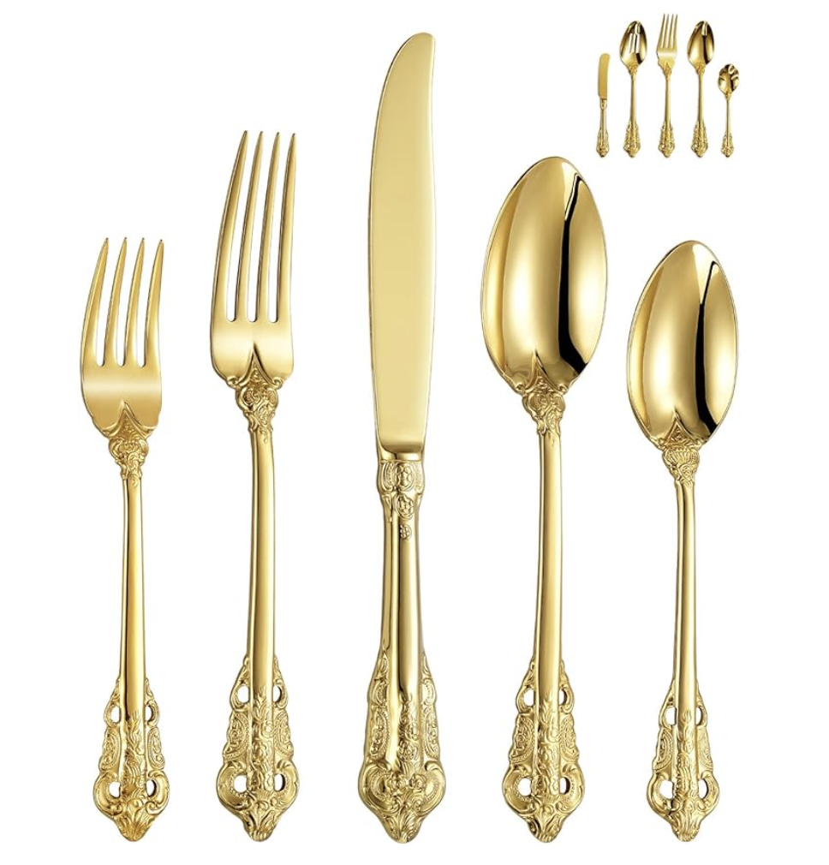
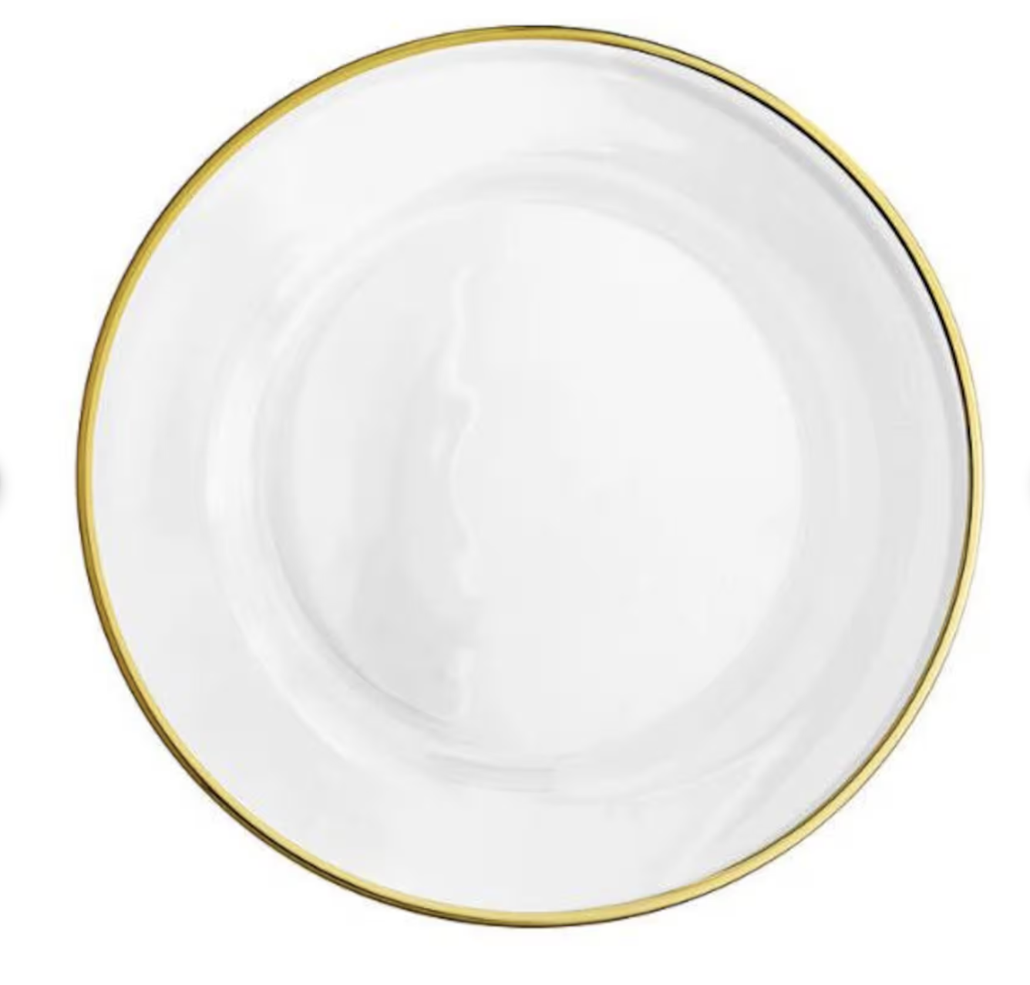
TABLEWARE
The tables will be dressed with gold-rimmed elements, including gold rimmed charge plate and royal gold flatware.
For the charger plates, you can choose between a gold-rimmed charger or a Firenze-inspired
The look will be beautifully completed with a satin ivory napkin.

Slide 12
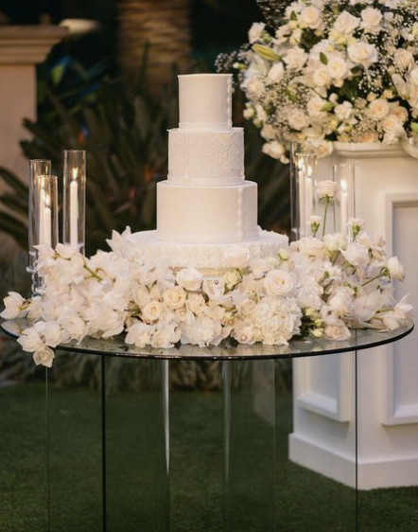
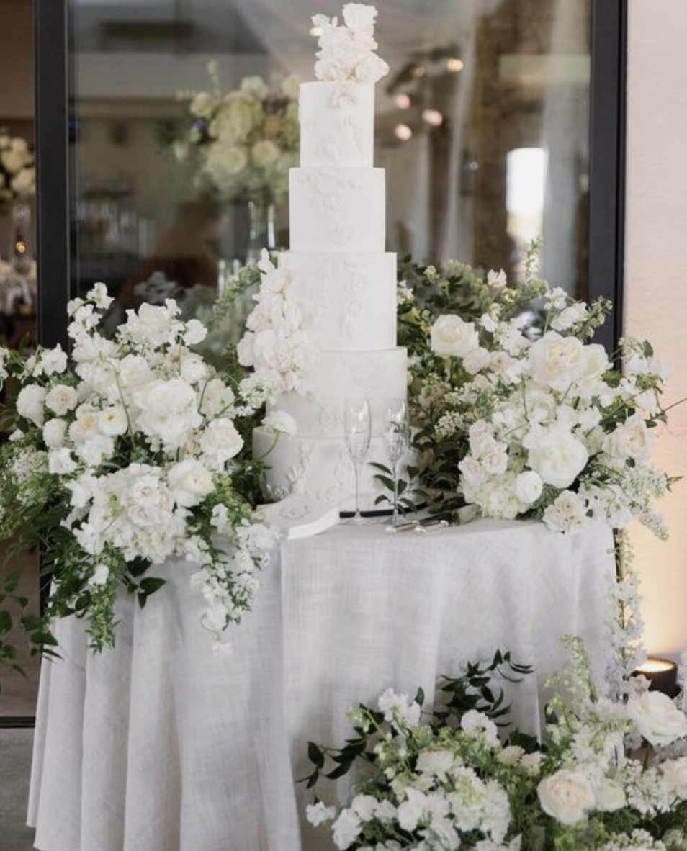
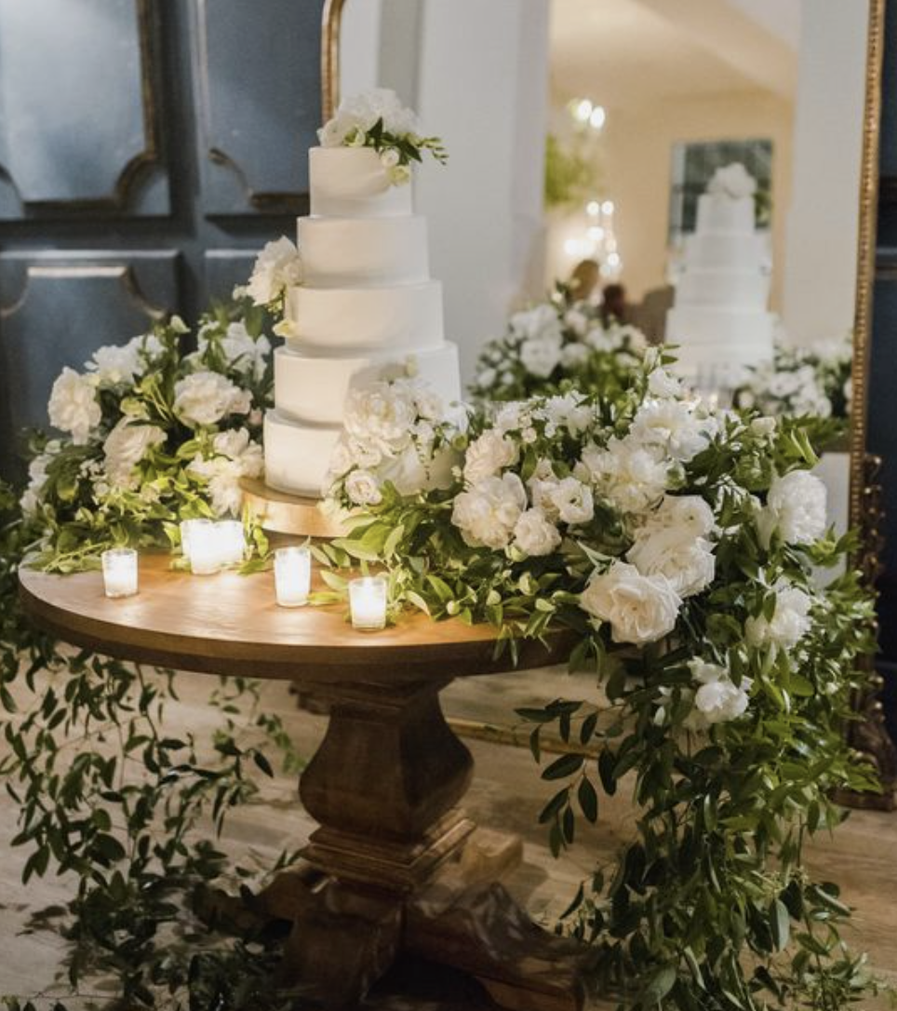
CAKE TABLE
The Cake table style will harmonize with the rest of the décor.
The idea is to have all the ceremony aisle flower arrangements to be re purposed as picture. →

Slide 13
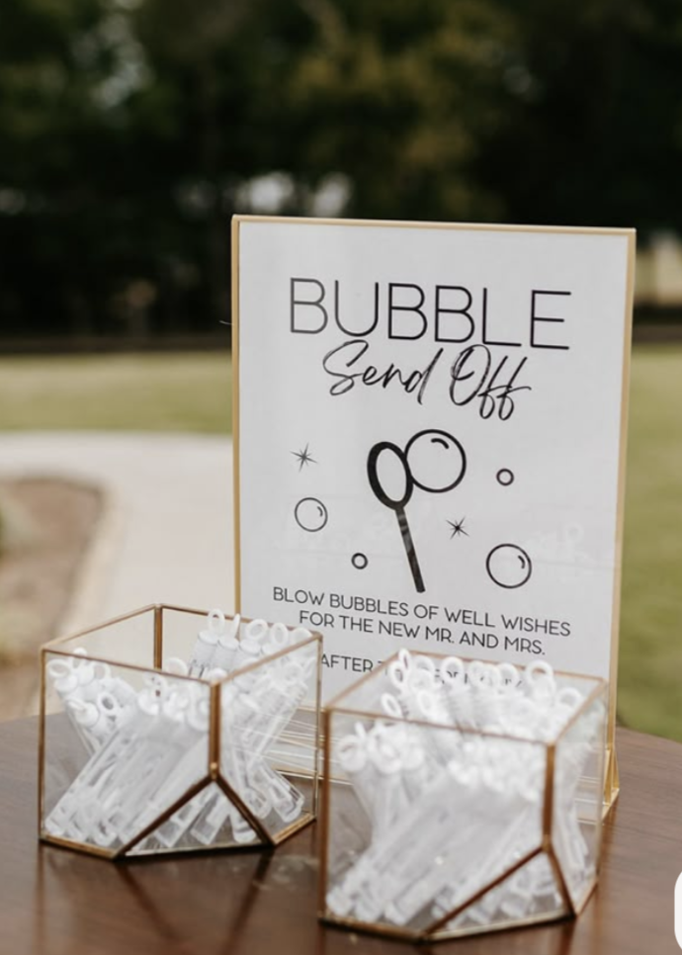
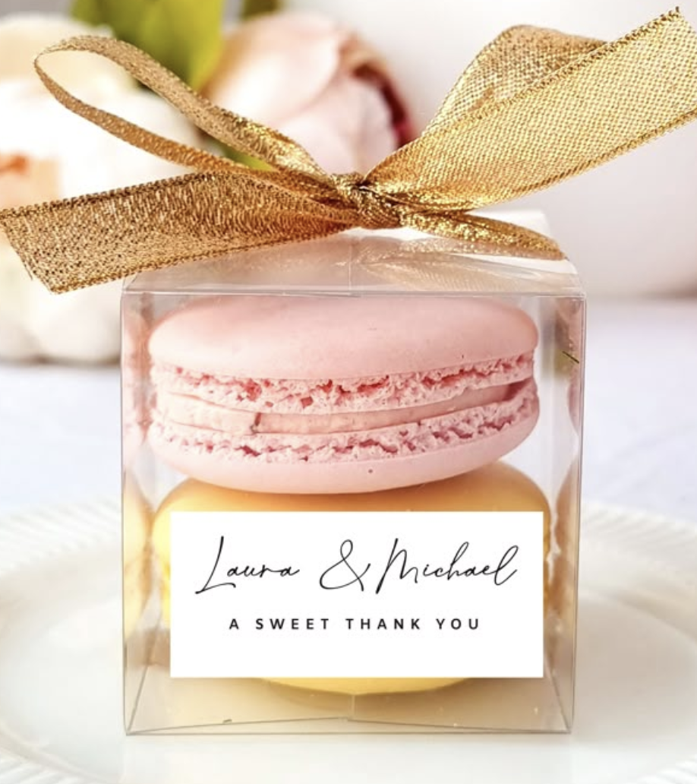
GUEST FAVORS & EXTRA PROPS IDEAS:
Bubble sign + bubble send off for 30 guests
Small customed
macaroons box

Slide 14
We can’t wait to bring your vision to life!
The concepts (written and images) in this proposal are symbolic of the design inspiration we intend to bring to life for your event. Due to the characteristics of perishable items (flowers), there can be situations that may emerge that are completely out of our control.
To protect the integrity of our creativity, we kindly ask that you do not share the details of this proposal with other vendors bidding for your event. This was made just for you. However, please feel free to share this with your family.

Slide 15
NOTES FOR PLANNER AND FLORIST TEAM ONLY (FRENCH):
1 Bouquet de mariée
1 Boutonnière du marié
Décor de la Cérémonie et de l’allée
1 Table rectangulaire (jusqu’à 15 invités de chaque coté)
4 Tables mange debout pour l'heure du cocktail
1 décor pour la seating chart/Plan de table
1 décor pour le welcome sign / panneau de bienvenue
Re disposition des fleurs pour la table du Wedding Cake

